Slide 1
SystemScape
Final Defense

Slide 2
The Company

Slide 3
CAI-STA
Headquartered in Metro Manila, Philippines.
CAI’s global presence in the Asia Pacific Region.
marketing and sales platform
offers CAI tools, application services and consulting
to improve the Information Communication Technology management of its clients,

Slide 4
Analyst Team
systemscape

Slide 5
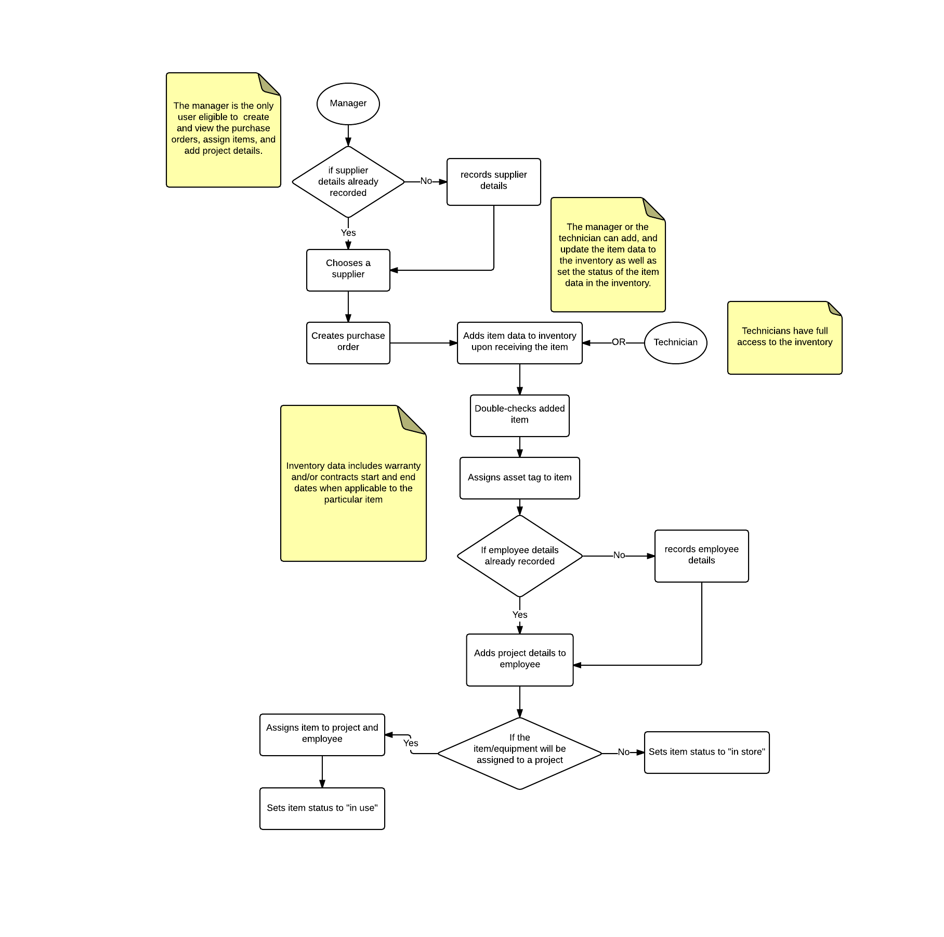
Business Process
PROBLEM:
The lists of suppliers and their corresponding contact persons are difficult to keep track of.

Slide 6
Business Process
PROBLEM:
The current approach in managing the inventory and purchase orders is open to inconsistencies between the different files used to store data.
The items listed in the inventory are difficult to filter and sort.

Slide 7
Business Process
PROBLEM:
The ends of warranties and contracts are difficult to keep track of.
The license key for software is sensitive and vulnerable to theft.

Slide 8
Business Process
PROBLEM:
The assignments of items to employees and projects are difficult to keep track of

Slide 9
Software Objectives and Scope
To provide a facility for managing inventory
To provide a facility for managing suppliers
To provide a facility for managing purchase orders
To provide a facility for keeping track of contracts and warranties
To provide a facility for keeping track of item and project assignments to employees
To notify the manager about any upcoming expiries of contracts and warranties
To generate inventory reports

Slide 10
Software Objectives and Scope
Item Assignment:
Employee can be assigned to multiple Projects
Projects can have multiple employees
An item can be assigned to an employee
Security:
Only the manager can access a software’s license key
Reports:
Generated reports will be exported into a .csv format
Printing of the report will not be covered by the software
Suppliers:
Canvassing of the suppliers will not be covered by the software

Slide 11
User Stories
User logs in and manages accounts
01 - Log In
18 - Grant Admin Rights
02 - Modify Login Details

Slide 12
User Stories
User manages inventory
23 - View Inventory
25 - Add Item Through Purchase Order
24 - Add Item
26 - Update Item
03 - Export Inventory Data

Slide 13
User Stories
User manages suppliers
05 - Record Supplier Details
06 - Update Supplier Details
04 - View Suppliers

Slide 14
User Stories
User manages purchase orders
08 - Create Purchase Order
09 - Update Purchase Order
07 - View Purchase Orders
10 - Export Specific Purchase Order

Slide 15
User Stories
User manages contract and warranty expiry dates
11 - Record Contract Expiry Dates
13 - Record Warranty Expiry Dates
12 - View Incoming Contract Expiry Dates
14 - View Incoming Warranty Expiry Dates

Slide 16
User Stories
User manages projects
20 - Add Projects
19 - View Projects

Slide 17
User Stories
User manages and assigns items and projects to employees
16 - Add Employees
15 - View Employees
17 - Update Employee Details
21 - Assign Items to Employees
22 - Assign Employees to Projects

Slide 18
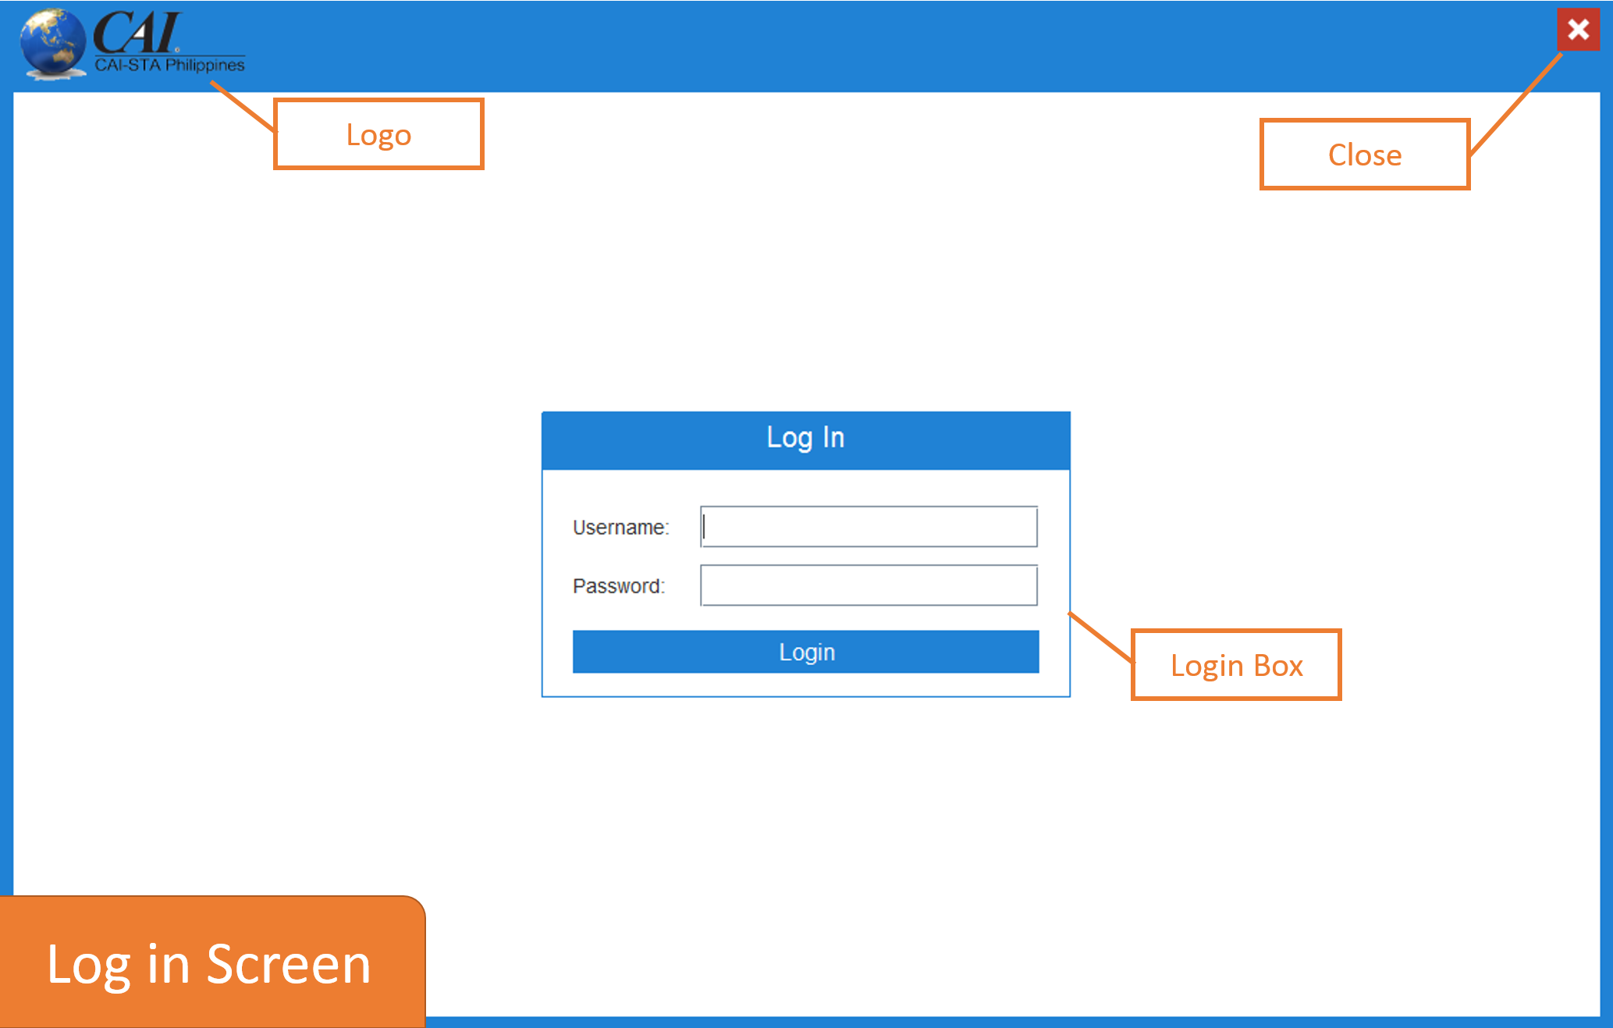
User Interface Design

Slide 19
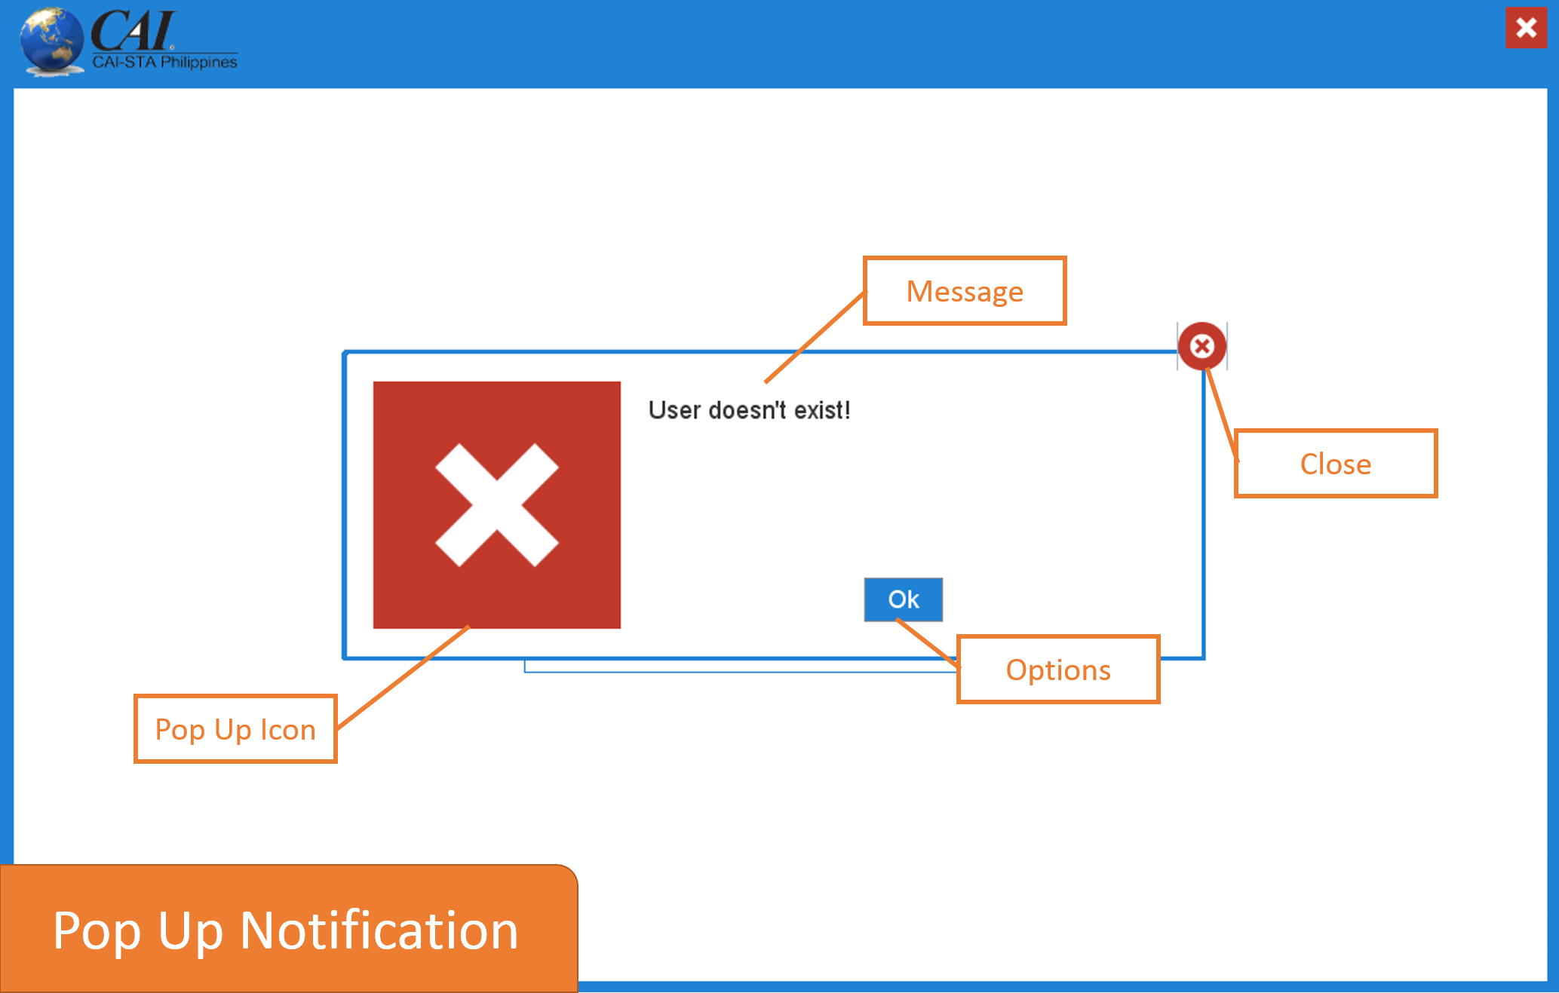
User Interface Design

Slide 20
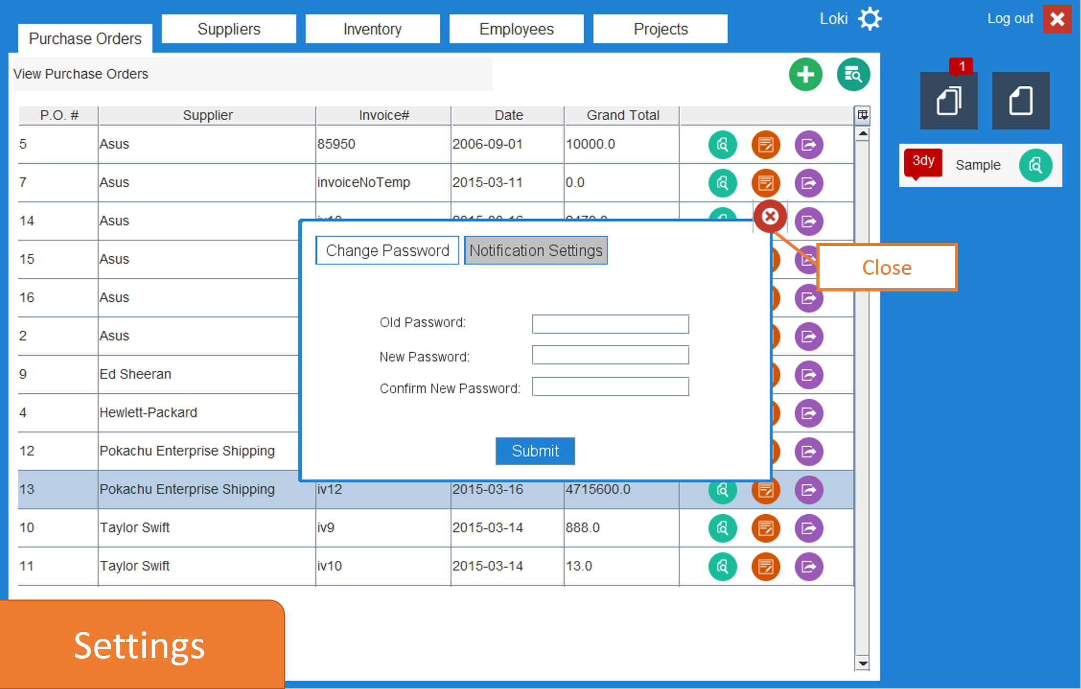
User Interface Design

Slide 21
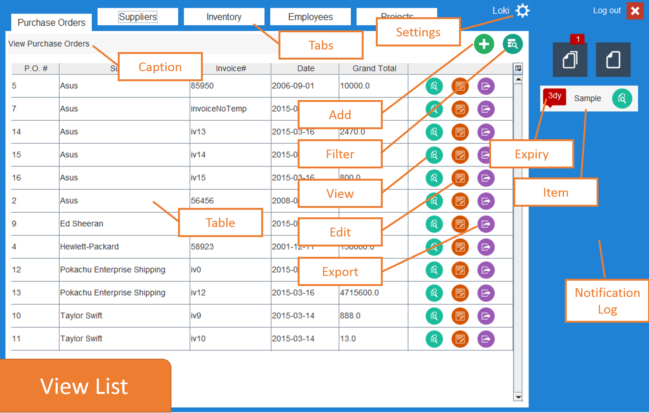
User Interface Design

Slide 22
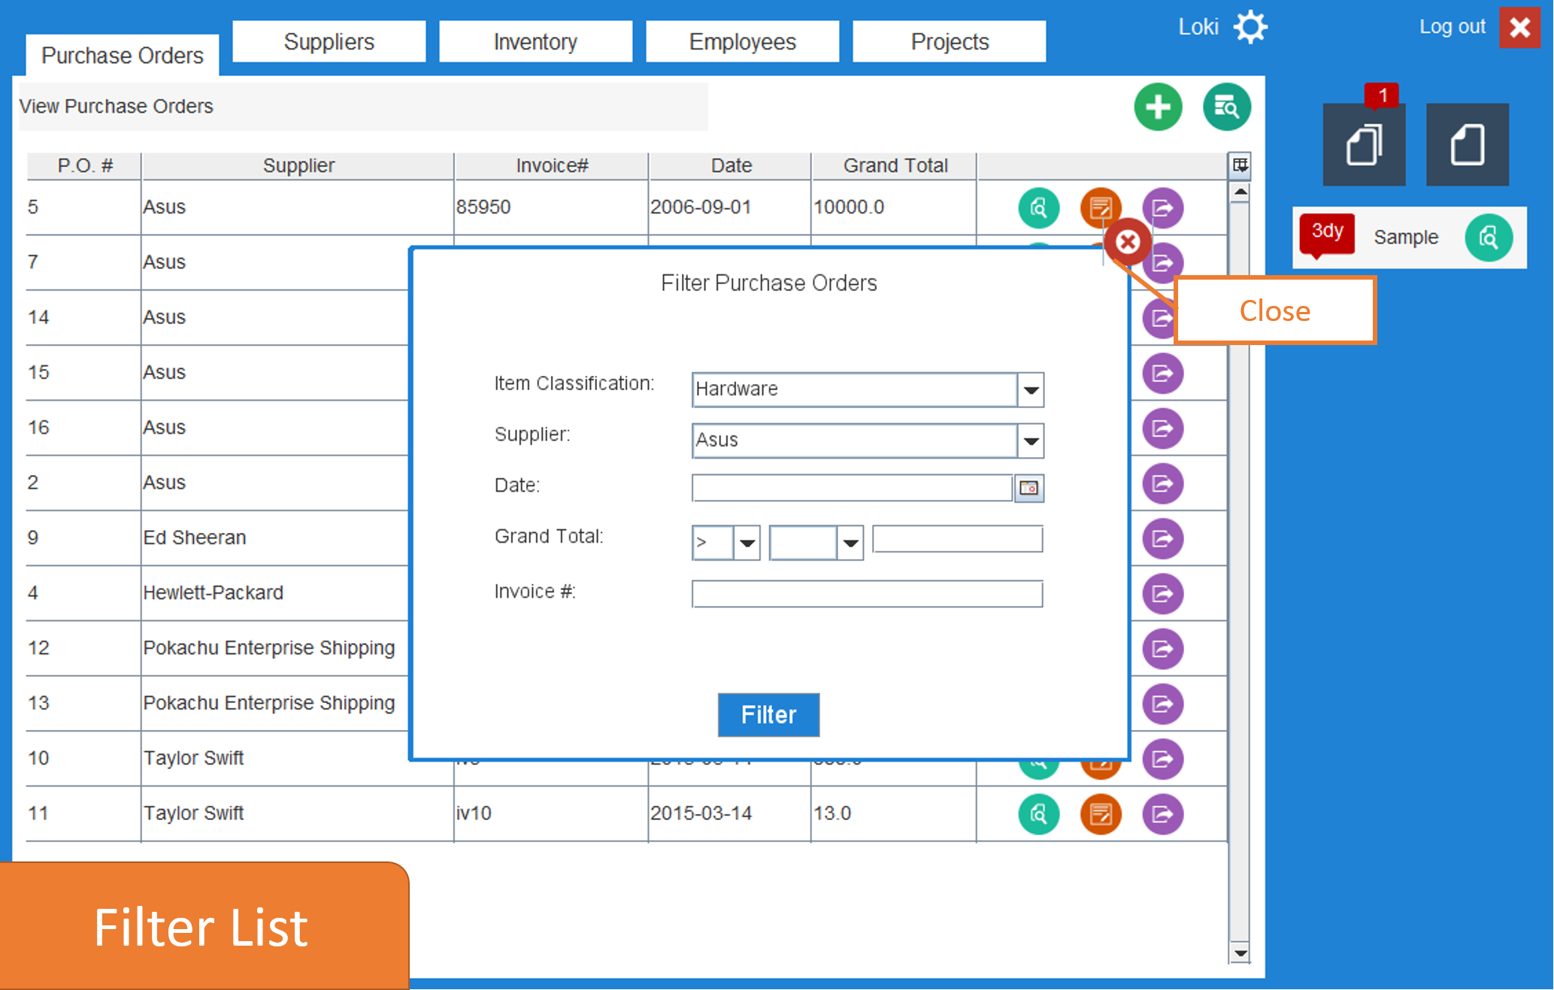
User Interface Design

Slide 23
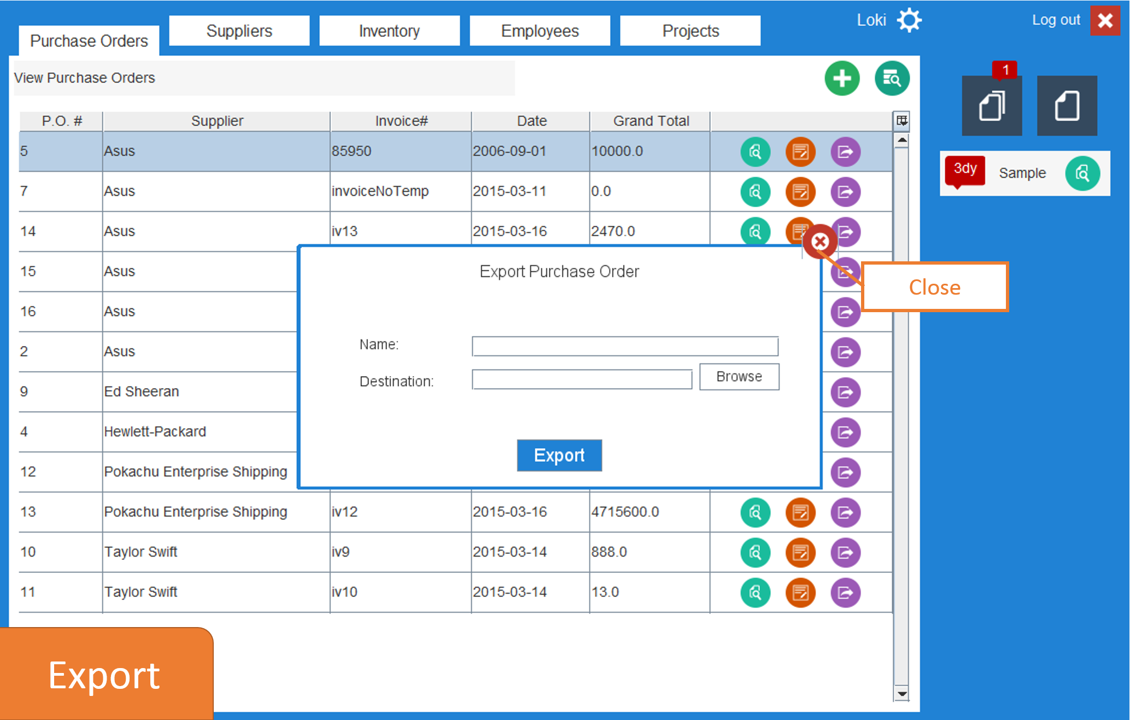
User Interface Design

Slide 24
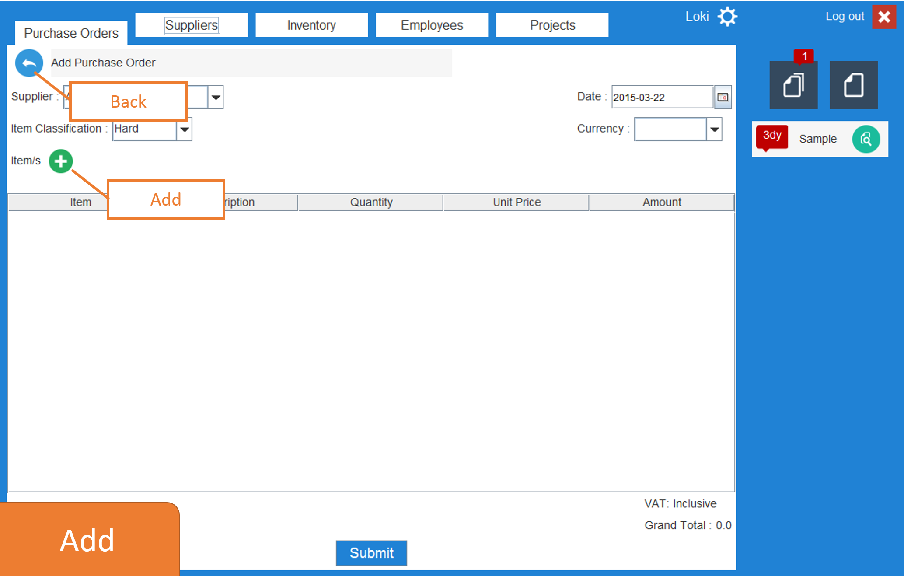
User Interface Design

Slide 25
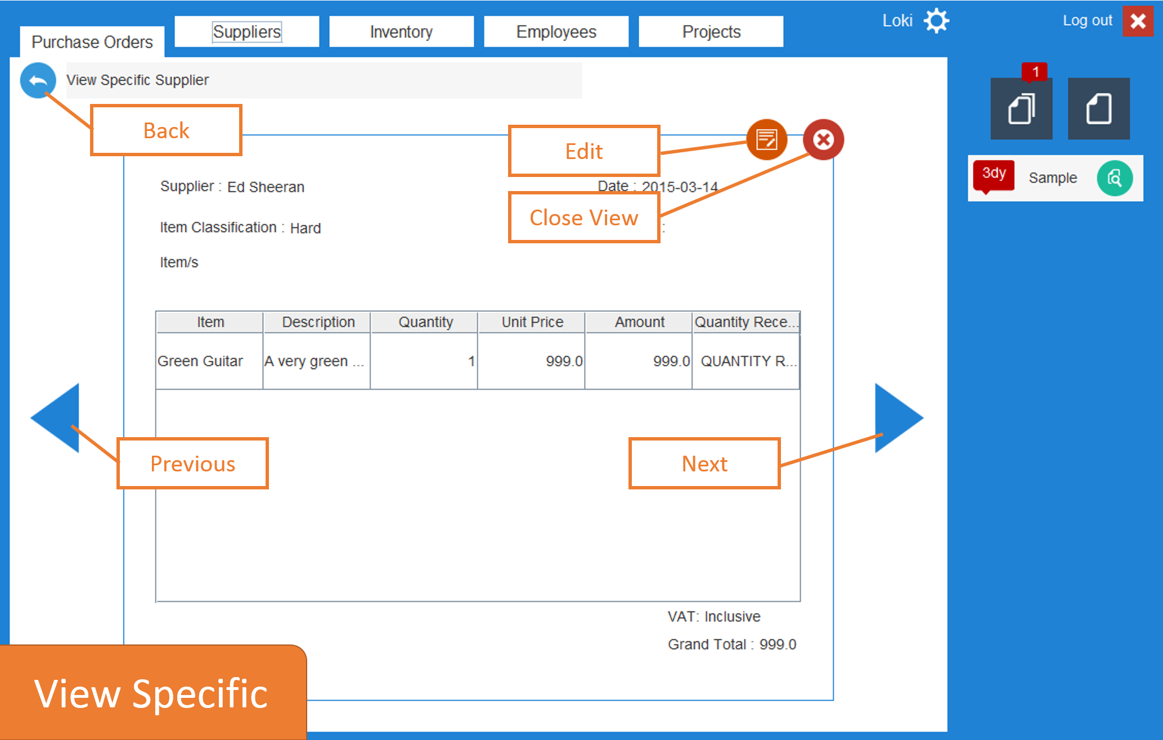
User Interface Design

Slide 26
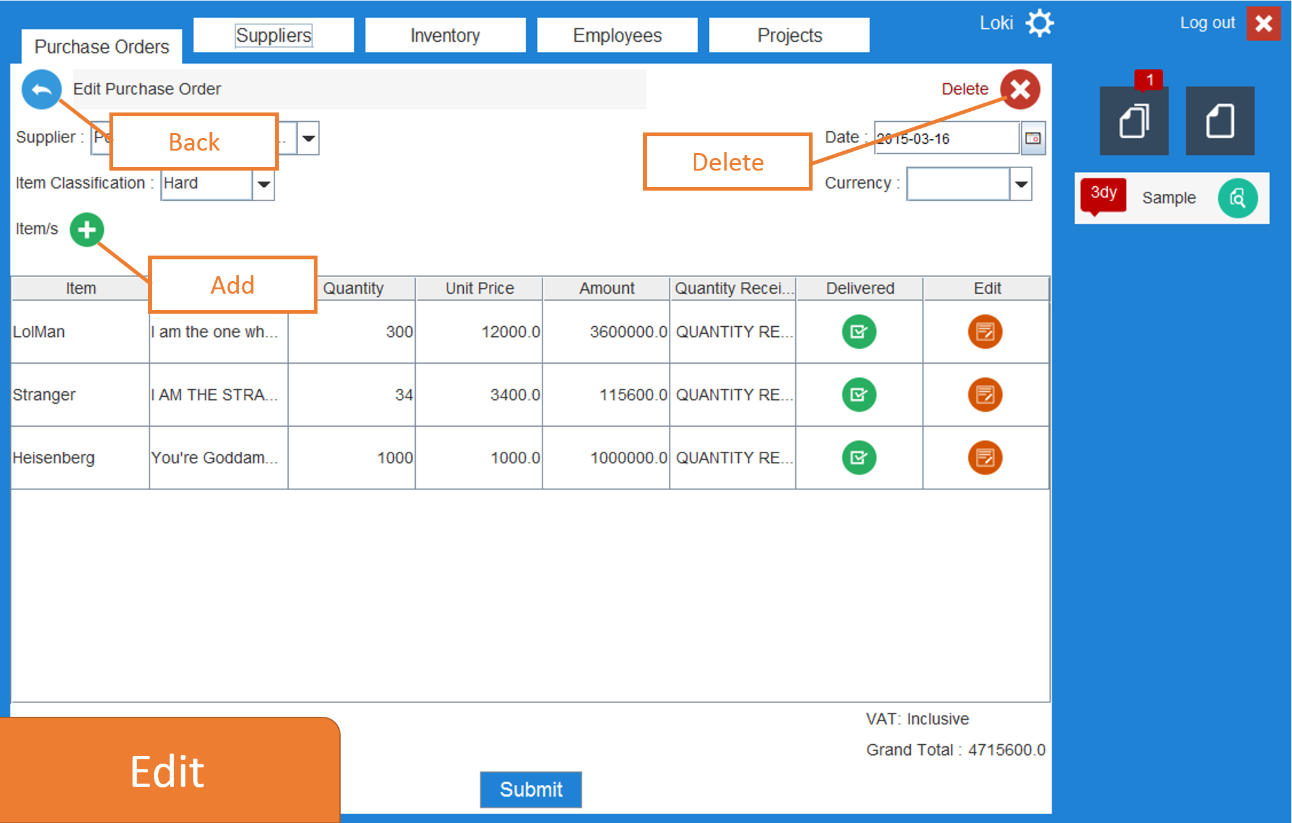
User Interface Design

Slide 27
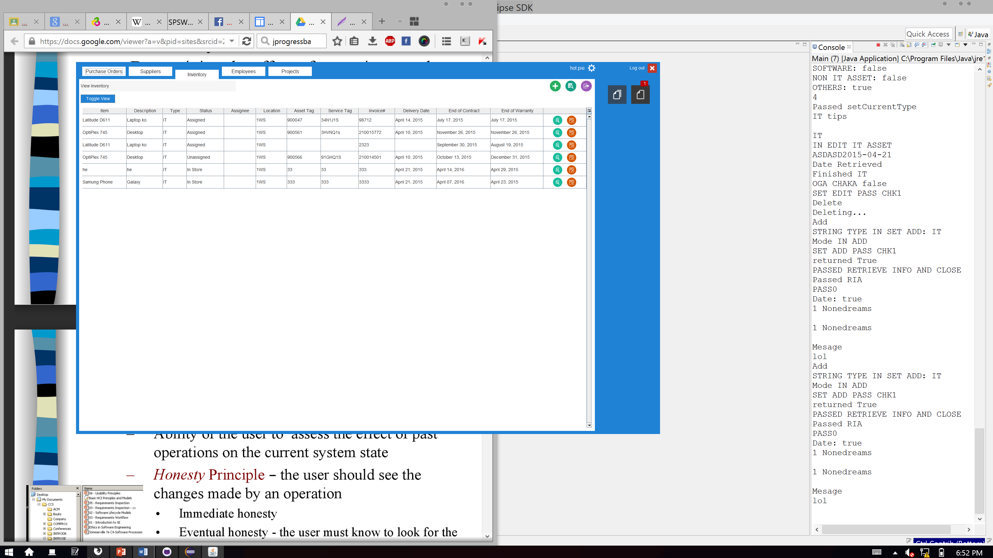
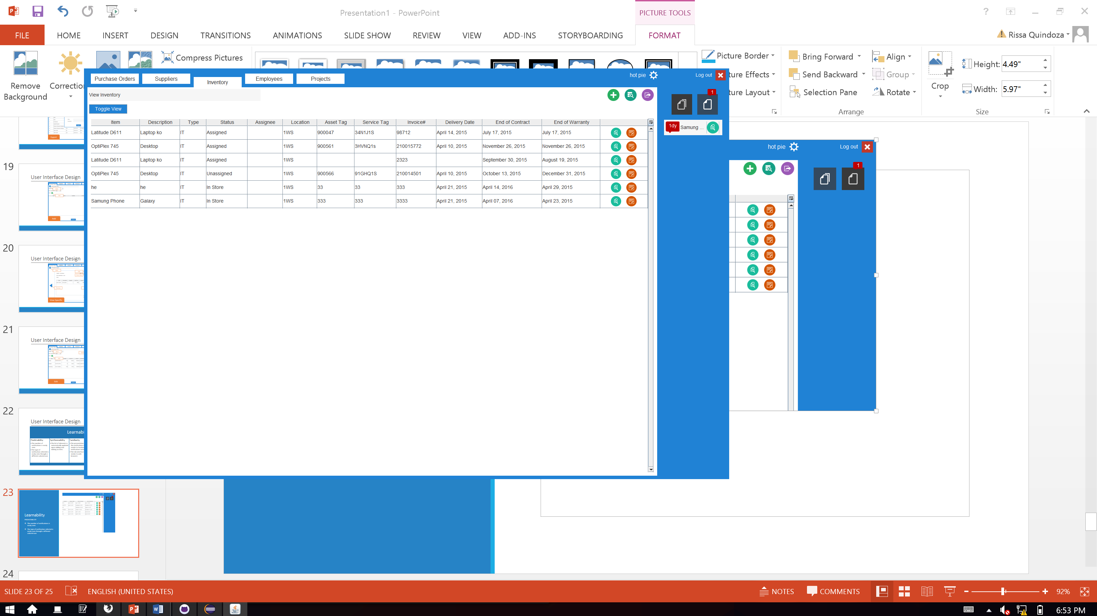
Learnability
PREDICTABILITY
The number of notifications is easily seen
The type of notification selected is easily seen through a different colored icon

Slide 28
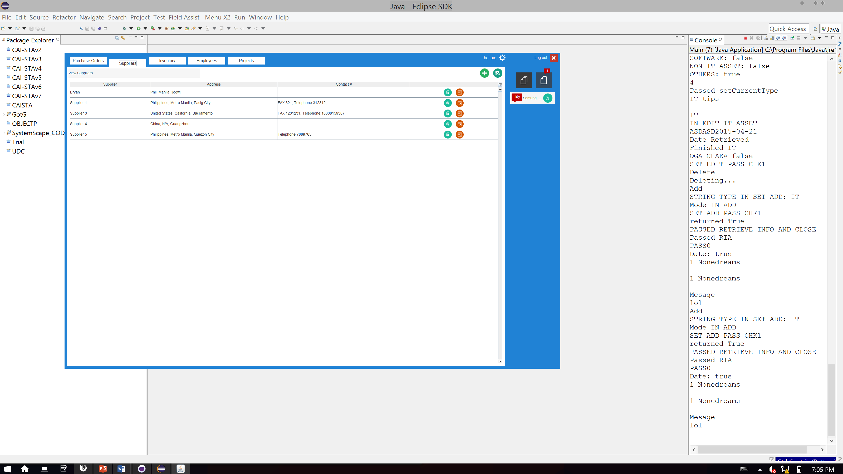
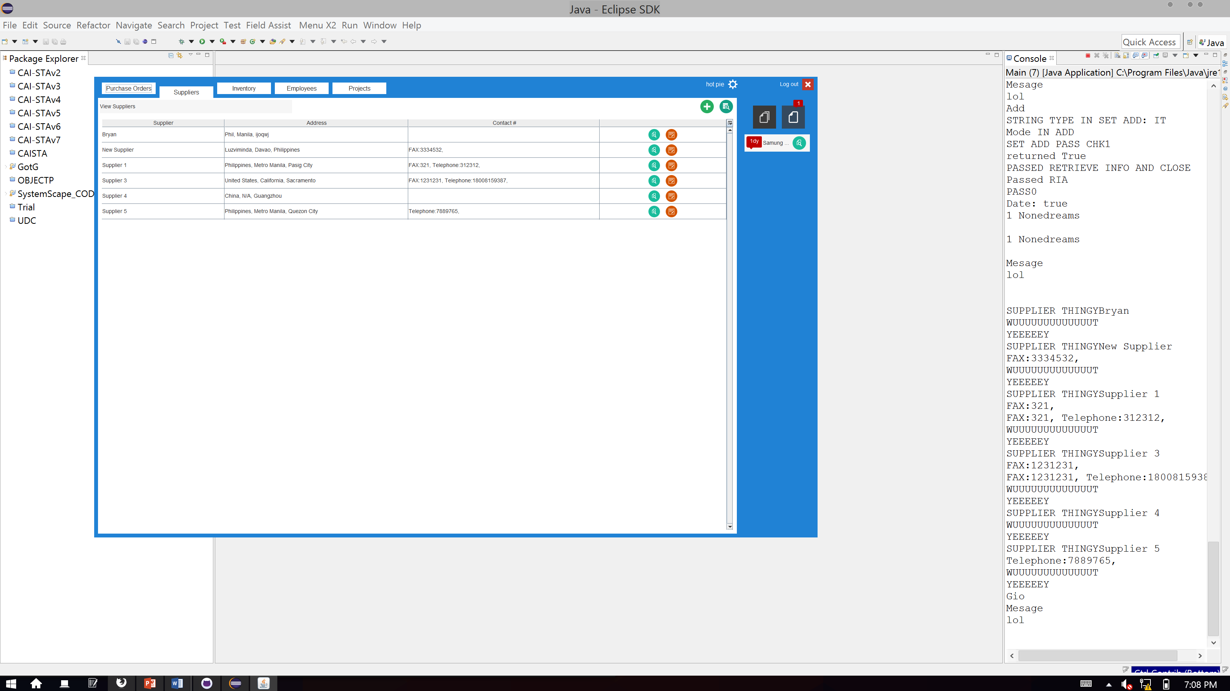
Learnability
SYNTHESIZABILITY
The list of elements is automatically updated upon adding and editing an item.

Slide 29
Learnability
FAMILIARITY
The presentation of the notifications is similar to Facebook’s notifications interface
The tab interface is similar to web browsers

Slide 30
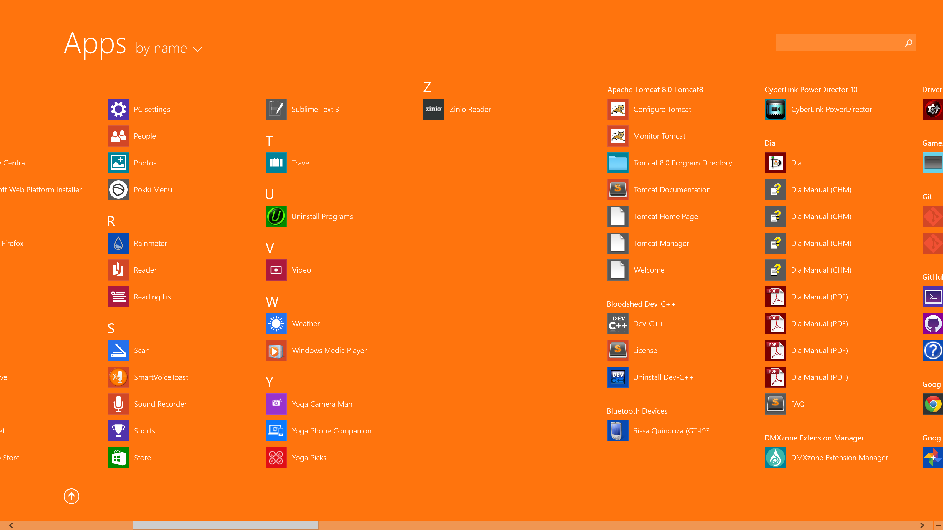
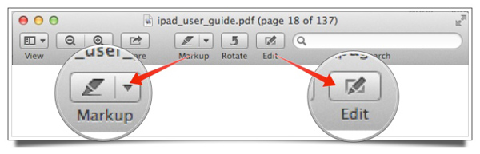
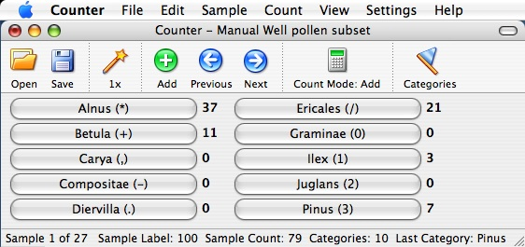
Learnability
GENERALIZABILITY
The icons used are similar to Windows and Mac icons

Slide 31
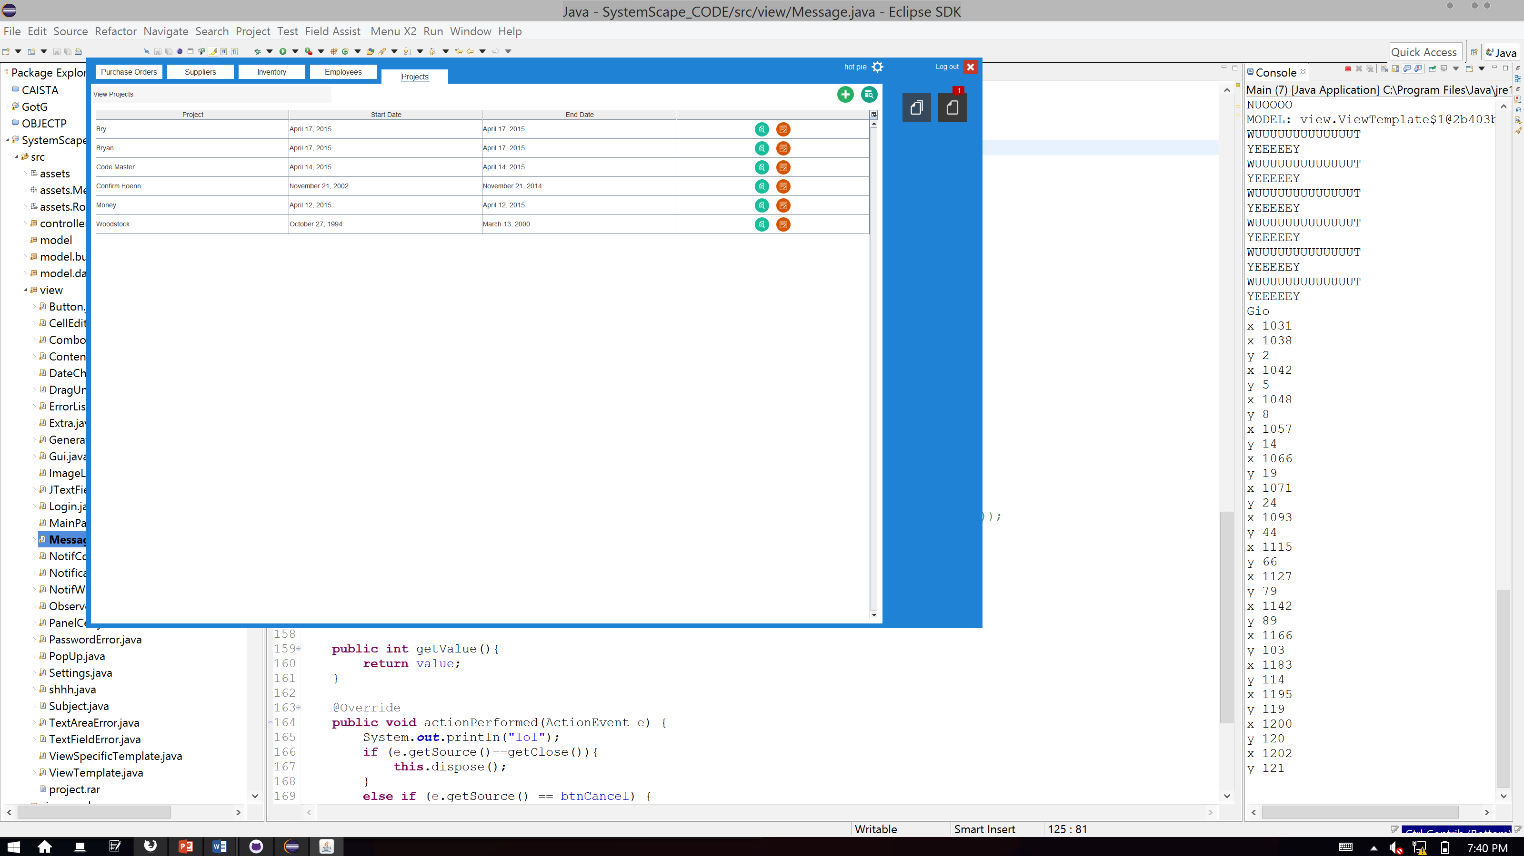
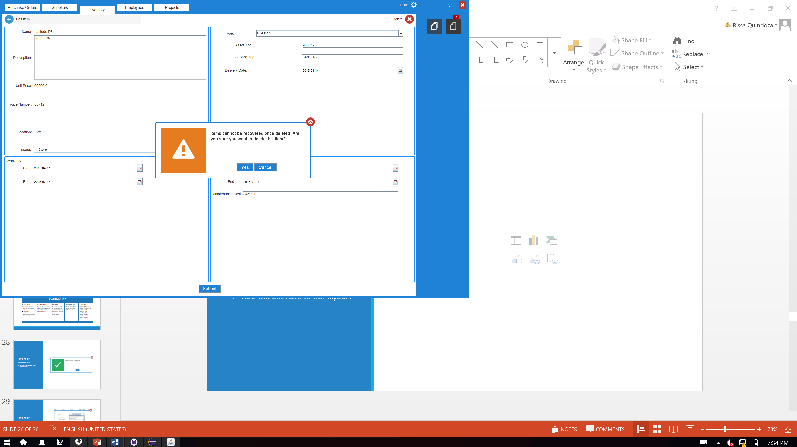
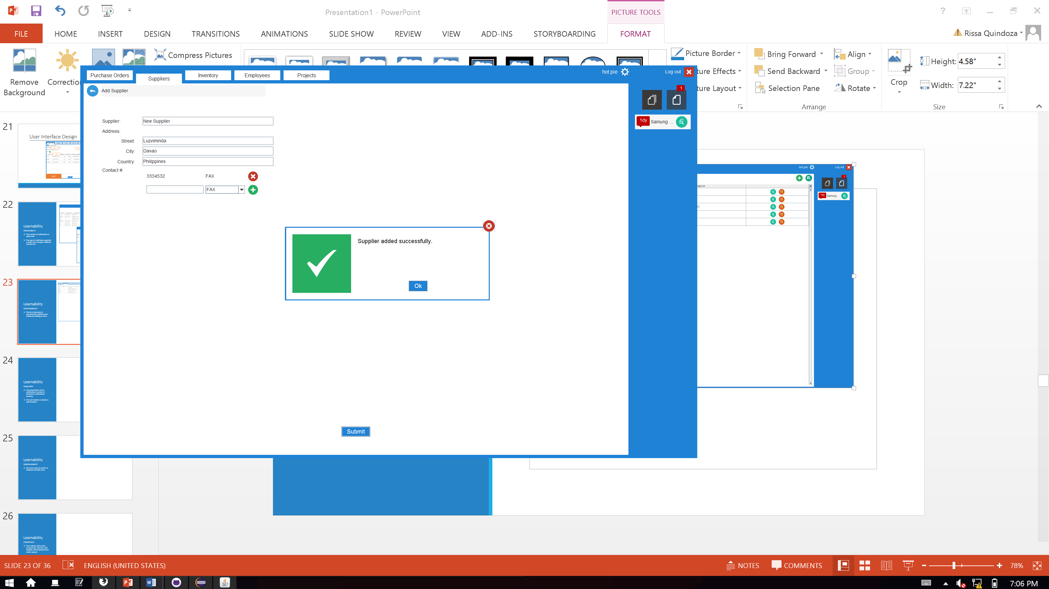
Learnability
CONSISTENCY
The modules with similar purposes (ex. add item, add supplier, add employee) have similar layouts
Notifications have similar layouts

Slide 32
User Interface Design
Learnability
Predictability
Synthesizability
Familiarity
Generalizability
Consistency
The number of notifications is easily seen
The type of notification selected is easily seen through a different colored icon
The list of elements is automatically updated upon adding and editing an item.
The presentation of the notifications is similar to Facebook’s notifications interface
The tab interface is similar to web browsers
The icons used are similar to Windows and Mac icons
The modules with similar purposes (ex. add item, add supplier, add employee) have similar layouts
Notifications have similar layouts

Slide 33
Flexibility
DIALOGUE INITIATIVE
System prompts user with notifications

Slide 34
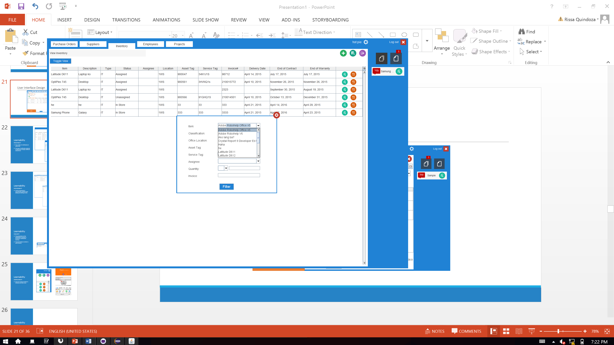
Flexibility
TASK MIGRATABILITY
System suggests entries upon user input to reduce errors

Slide 35
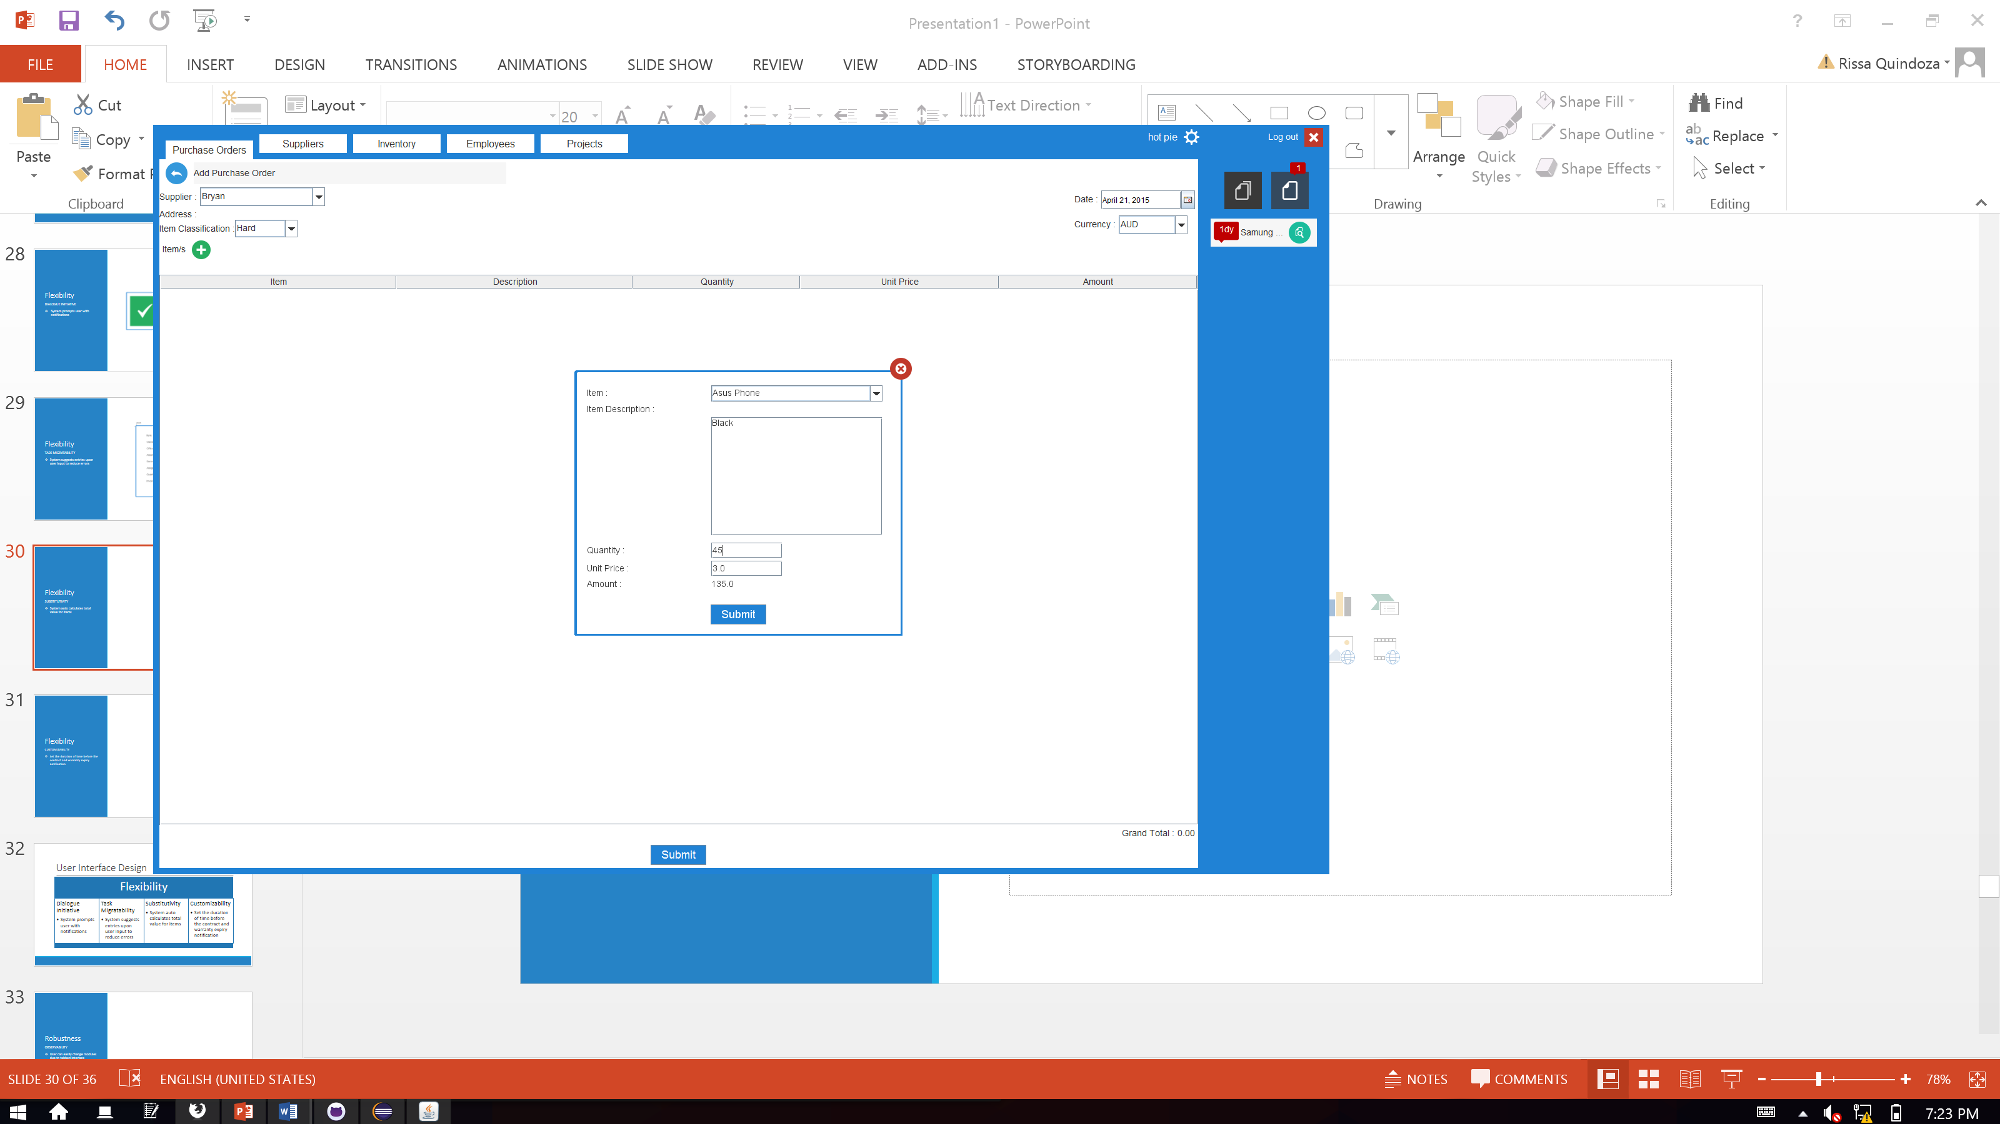
Flexibility
SUBSTITUTIVITY
System auto calculates total value for items

Slide 36
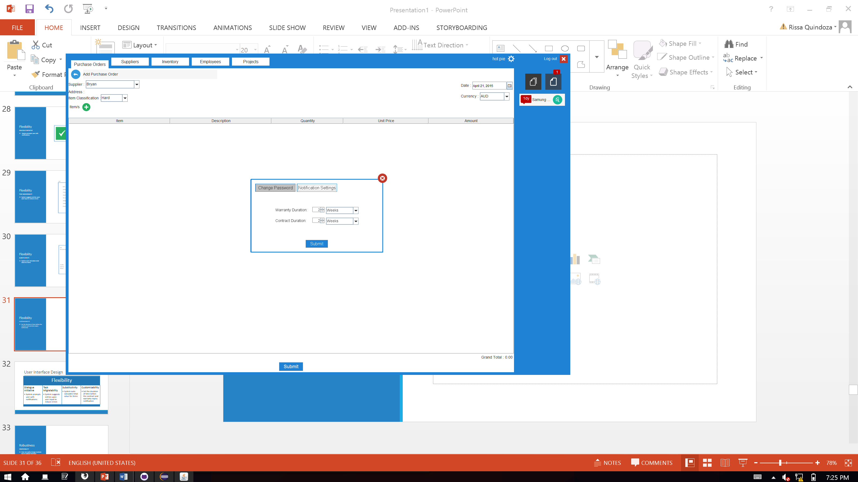
Flexibility
CUSTOMIZABILITY
Set the duration of time before the contract and warranty expiry notification

Slide 37
User Interface Design
Flexibility
Dialogue Initiative
Task Migratability
Substitutivity
System prompts user with notifications
System suggests entries upon user input to reduce errors
System auto calculates total value for items
Customizability
Set the duration of time before the contract and warranty expiry notification

Slide 38
Robustness
OBSERVABILITY
User can easily change modules due to tabbed interface
User can easily view notifications due to the notification log area

Slide 39
Robustness
RECOVERABILITY
System prompts the user for important notifications

Slide 40
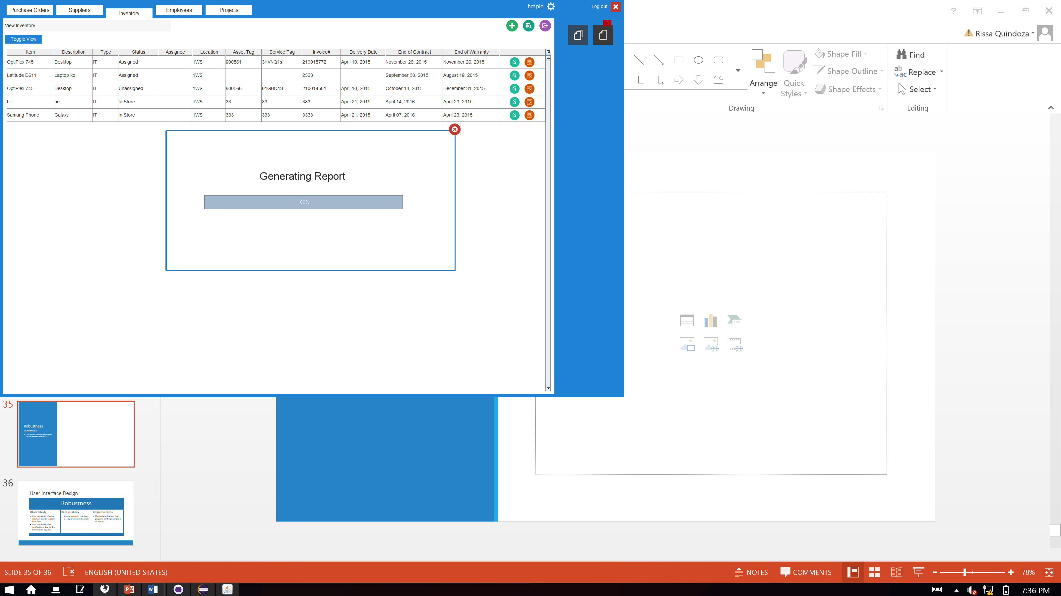
Robustness
RESPONSIVENESS
The system displays the progress of the generation of report

Slide 41
User Interface Design
Robustness
Observability
Recoverability
Responsiveness
The system displays the progress of the generation of report
System prompts the user for important notifications
User can easily change modules due to tabbed interface
User can easily view notifications due to the notification log area

Slide 42
ERD

Slide 43
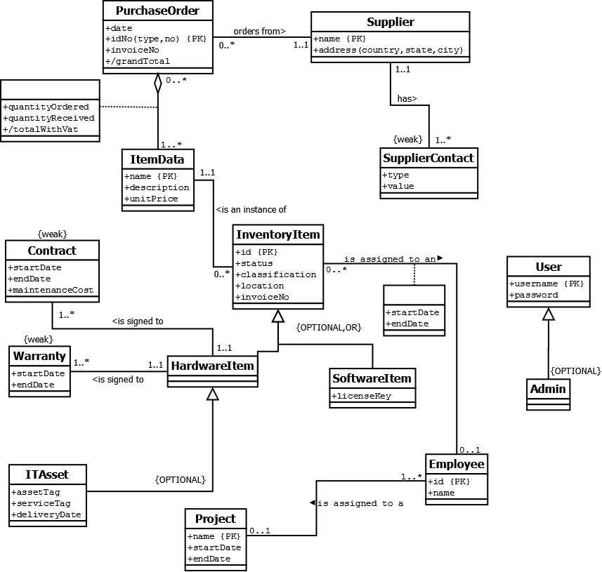

Slide 44
Demo

Slide 45
Quality Assurance

Slide 46
Static Testing

Slide 47
Requirements Specification
Inconsistencies in sentence structure/format
References to UI elements
Inconsistencies between transcript, business process, problems and user stories
Untraceability of user stories back to problems
Notes:
Inconsistencies in sentence structure/format
Inconsistent tense (
Inconsistent use of titles (“the manager” & “Manager”)
Inconsistent structure (“As a technician, I can…” & “A technician can…”) (“The manager can click” & “The manager clicks”)
References to UI elements
“The technician clicks a button”
“using radio buttons”
Inconsistencies among transcript, business process, problems and user stories
Misunderstandings between the members of the group concerning the objectives of the software and what the software does
Untraceability of user stories back to problems
Some user stories were not traceable back to any of the identified problems
Miscellaneous
Interactions that don’t actually refer to interactions
There is a portion of the screen dedicated for notifications.

Slide 48
UI Reviews
Non-compliance with coding standards
Usability of the software
Inconsistencies between user interface elements
Inconsistencies between user interface and specifications
Notes:
Non-compliance with coding standards
Replace "Log In" with "Sign In"
Usability of the software
The need to ask questions about how to use or navigate the software
Field "Name" is vague in the sense that it is not immediately obvious that it refers to the filename, and it is difficult to figure out whether to include the extension or not or even what the file extension is supposed to be
Unexpected effects of user interactions
Click and drag any part of the gui will result in moving the whole gui
Even when the status is set to "Unassigned", the user is still able to select an employee as the "Assignee"
Lack of form clearing and closing after submission
The filter criteria panel does not close when the user clicks submit.
Login fields do not clear after login, so when a user logs out, the old login details are still entered
Inconsistencies in user interface elements
There is no consistency in what pop-up messages do upon exit; when clicking "Ok" after when a message pops up after editing or adding an item, sometimes the user is returned to the view, and sometimes the user remains at the adding or editing part
Inconsistencies between user interface and specifications
Status of inventory items as “Unassigned” or “Assigned” didn’t match the specifications wherein they were labeled as “In Store” or “In Use”
Miscellaneous
Random overlooked details
After modifying a supplier, the message displayed says "Supplier added successfully."

Slide 49
Code Reviews
Non-compliance with coding standards
Improper or unnecessary implementation of design patterns
Redundant code
Notes:
Non-compliance with coding standards
Coding standards breach: attribute "ii" should be "inventoryItem"
The method does not have "is" included in its name
Improper or unnecessary implementation of design patterns
In an attempt to use the “iterator pattern”, they would convert everything to ArrayLists and then return the iterators
Redundant code
When accessing the database, the same statements are executed and written every single time
Miscellaneous
Inappropriate or misleading method names
public Iterator getSupplierContact(): The name of this method is misleading

Slide 50
Functional & User Acceptance Testing

Slide 51
Iteration Testing (2nd Round)
Lack of messages to inform the user of an action’s success or failure
Lack of error checking
Missing features
Notes:
Lack of messages to inform the user of an action’s success or failure
Lack of error checking
Blanks
Wrong data-types
Start dates of time periods after end dates
Missing features
At the time of testing
Proper adding of supplier addresses (still using the drop-down)

Slide 52
Functional Testing (Iteration 2)
Inability to process empty database tables
Creation of new items when editing old items
Inconsistency between display and database values
Lack of or incorrect messages to inform the user of an action’s success or failure
Missing features
Notes:
Inability to process empty database tables
Immediately after logging in, the system returned null pointer exception.
Creation of new items when editing old items
Upon changing an inventory item type
Upon editing a supplier name (fixed in 2nd round)
Inconsistency between display and database values
Display of contract, warranty and delivery dates (fixed in 2nd round)
Missing features (all fixed in 2nd round)
Filter
Export (purchase orders still not fixed)
Grant/remove admin privileges
Assign items to employees
License key encryption (still not fixed)
Modify login details
Lack of messages to inform the user of an action’s success or failure
Submission of an existing supplier (displays success but doesn’t add it) (fixed in 2nd round)
Miscellaneous
Does not check for contact details
Does not check for wrong dates
Does not allow deleting of items in purchase orders

Slide 53
User Acceptance Testing 1
Implementation of filtering
Implementation of PO# format (HARD-1076-01-<AUTO_INC>)
Fixing the adding of hardware purchase orders
Automatic update of notifications
Tooltip text for icons
Notes:
Filter
PO#
1076-01-<AUTO_INC>
HARD-1076-01-<AUTO_INC>
Supplier Must be displayed
Add Supplier -> drop-down PO
Viewable Address PO Form
Add Item from PO -> HARD?
Notifications, automatic
Vat no "inclusive"
Tooltip text
pls
Date Format
Month in words day, year e.g. April 10, 2015
Project, just the date
PO -> price commas and precision e.g 1,000,000.00

Slide 54
User Acceptance Testing 2
Responsive assignee fields for inventory items
Automatic filling up of fields based on item
Ability for user to fix errors before exiting
Automatic update of notifications
Tooltip text for icons
Viewing of details by clicking the cell
Notes:
Non-responsive assignee fields for inventory items
Automatic filling up of fields based on item
Add/Edit PO
Ability for user to fix errors before exiting
When there is an error, after showing the error message, the system exits to the view (add/edit inventory)
Automatic update of notifications
Requires login - logout
Miscellaneous
Center aligned quantity column
Supplier address attributes to street, city, country
Remove VAT
End and start date in wrong order (assignee, add/edit inventory item)
Allowing the user to select from existing projects (combobox) (add/edit projects)
Show purchase order number
Change display layout for project description (view projects)
Remove unnecessary things (e.g. time) (view specific project)
Change Loki to actual username

Slide 55
Conclusions

Slide 56
Conclusions and Recommendations
Solution
Warranties and contracts
Inconsistencies
Filter and Sort
Assignments
Supplier Tracking
Security

Slide 57
Findings and Recommendations
Minor UI errors
Work on Export PO
Speed up loading
Fix minor UI errors

Slide 58
SE Principles
Elicitation Techniques
Requirements Validation
Design and Construction
Usability
Verification and Validation
Testing

Slide 59
Improvements
Strict Iterative
Enforce Integration Early

